Slide 1
Our SOUL Care is Sacred
2024 South Central Jurisdiction
Quadrennial Meeting
St. Louis, Missouri
Kelly G. Loeb
Workshop Presenter
Wherever you stand, be the SOUL
of that place
-Rumi
Notes:
Title slide with four levels of content. Use this to start your presentation.

Slide 2
Smooth Sailing: Our SOUL Care is Sacred
SS SOUL Care
2024 South Central Jurisdiction Quadrennial Meeting
Sail Date: June 21, 2024
Embarkation Location: Renaissance Hotel, St. Louis, MO
Wherever you stand, be the SOUL of that place -Rumi

Slide 3
Objectives
By the end of this session, United Women in Faith leaders will:
Take a fantastic voyage into SOUL Care
Seek, Spell Out and Savor SOUL Care
Open, Observe and Optimize SOUL Care
Unveil, Understand and Universalize SOUL Care
Launch, Live and Lead SOUL Care
Disembark with SOUL Care Souvenirs and Support

Slide 4
Agenda
All Aboard the SS Soul Care! Welcome, Introduction, Embarkation
Captain’s Log: Sailing Scripture
In This Very Room
Ports of Call
Shore Excursions
Disembarkation: Souvenirs and Support
Lovingkindness Meditation

Slide 5
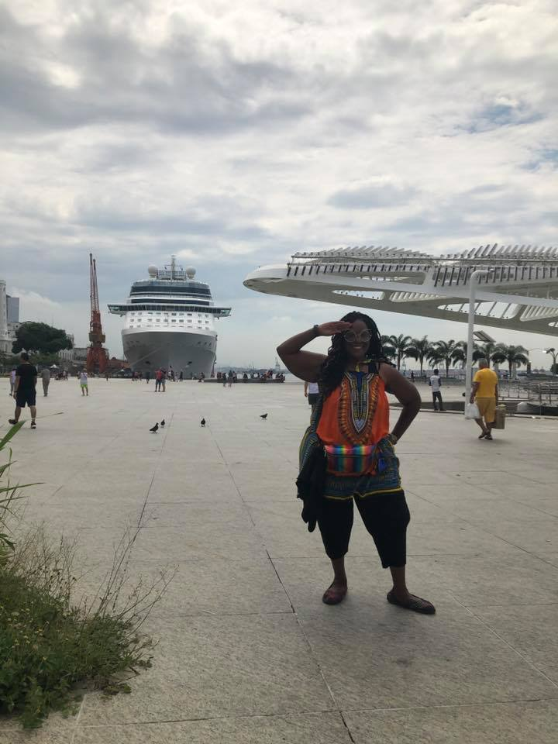
ALL ABOARD the SS Soul Care!
Communications Coordinator
South Central Jurisdiction
United Women in Faith
Technical Advisor & Website Administrator
Associate Dean, Mission u
Missouri Conference United Women in Faith
Board of Ordained Ministries
Missouri Conference United Methodist Church
Master SOULcial Worker & Aging Advocate
Daughter of Peggy G. and Charles P. Loeb
Granddaughter of Grace C. Moore
Dweller in the home of
Mai H. Gray, First Black President of
United Methodist Women (1976-1980)
Your Captain: Kelly G. Loeb
Ahoy, mates!

Slide 6
Captain’s Log: Sailing Scripture
Philippians 3:12-16
¹²Not that I have already obtained all this, or have already arrived at my goal, but I press on to take hold of that for which Christ Jesus took hold of me.
¹³Brothers and sisters, I do not consider myself yet to have taken hold of it. But one thing I do: Forgetting what is behind and straining toward what is ahead, ¹⁴I press on toward the goal to win the prize for which God has called me heavenward in Christ Jesus.
¹⁵All of us, then, who are mature should take such a view of things. And if on some point you think differently, that too God will make clear to you. ¹⁶Only let us live up to what we have already attained.
-New International Version

Slide 7
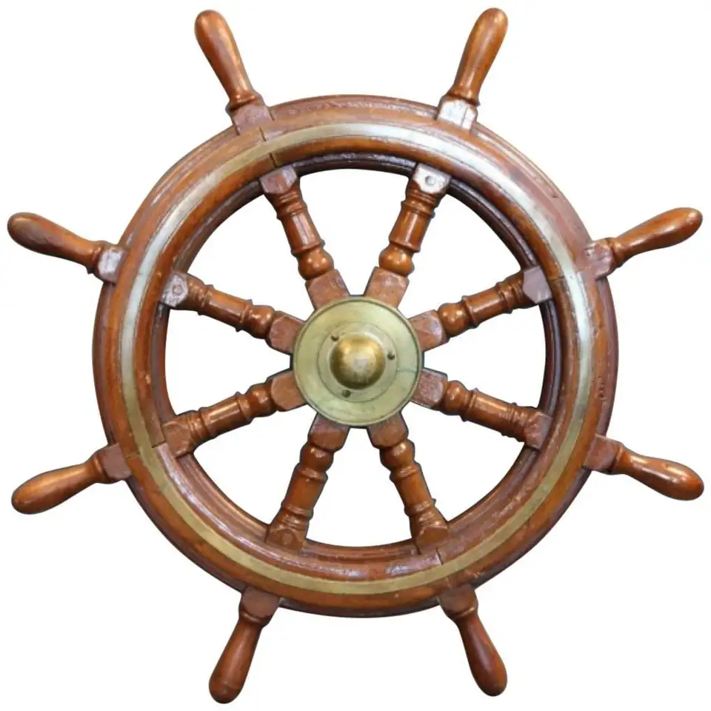
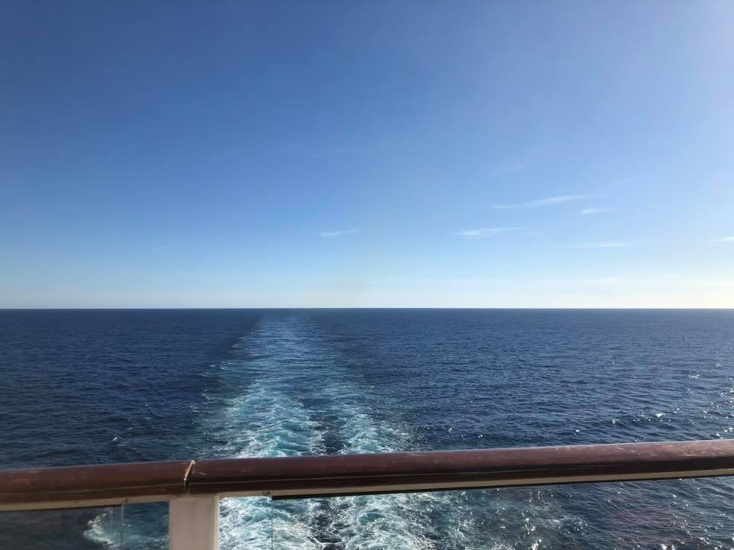
1st Port of Call: Seeking, Spelling Out and Savoring SOUL Care
What words describe how your head and your heart are arriving to this Quadrennial Meeting?
Why did you say yes to attending?
What comes to mind
when you think of SOUL Care?

Slide 8
In This Very Room
In this very room
There’s quite enough love
for one like me
And in this very room
There’s quite enough joy for one like me
And there’s quite enough hope
And quite enough power
To chase away any gloom
For Jesus, Lord Jesus
Is in this very room
YouTube video
Vocalists: The Lennon Sisters
Songwriters:
Ron Harris and Carol Harris

Slide 9
In This Very Room
And in this very room
There’s quite enough love
For all of us
And in this very room
There’s quite enough joy
For all of us
And there’s quite enough hope
And quite enough power
To chase away any gloom
For Jesus, Lord Jesus
Is in this very room

Slide 10
In This Very Room
And in this very room
There’s quite enough love
for all the world
And in this very room
There’s quite enough joy for all the world
And there’s quite enough hope
And quite enough power
To chase away any gloom
For Jesus, Lord Jesus
Is in this very room

Slide 11
2nd Port of Call: Opening, Observing and Optimizing SOUL Care
Drawing Together
Circle = Wholeness
Rectangle = Support
Triangle = Change
Bolt = Goal(s)
Star = Relationships

Slide 12
Kelly G. Loeb’s drawing
January 2023

Slide 13
3rd Port of Call: Understanding, Unveiling and Using SOUL Care
Staying afloat…
…just keep
swimming
…upstream

Slide 14
How To Treasure an Old Person
Seek out old people.
When you find some, give them joy.
Develop your patience. Tune up your sensitive humor.
Crack your shell. Remember that each old person is a library.
Listen closely.
Go for a slow walk in a sunny park.
Listen closely.
Be useful.
Bring the gift of yourself. Try enchantment.
Invent a new activity. Try playing their game.
Let wisdom seep in. Cradle your own future old person.
Hug willingly. Sew on a button. Handwrite a letter.
Be voluntary. Visit with magic.
Handle with caring. Be gentle. Make a nourishing soup.
Take a midnight cruise in a convertible.
Try respect. Bestow surprise gifts.
Believe in really living.
Pray together. Gamble on love.
Plant a tree in honor of your friendship.
Plan something outrageous.
Hold hands at twilight.
Bake hilarious cookies.
Listen closely.
Pay attention to an old person.
The treasures will be revealed.
Poet: Sark

Slide 15
4th Port of Call: Launching, Living and Leading SOUL Care

Slide 16
Shore Excursion Propositions
What’s next for you and your soul?
Is it well with your soul?
What does it feel like when peace attendeth your way?
Or when sorrows like sea billows roll?
with acknowledgement to songwriter Horatio G. Spafford

Slide 17
4th Port of Call: Launching, Living and Leading Lyrics! for SOUL Care
“It is Well With My Soul”
Horatio G. Spafford
When peace like a river attendeth my way
When sorrows like sea billows roll
Whatever my lot, thou has taught me to say
It is well, it is well with my soul

Slide 18
4th Port of Call: Launching, Living and Leading Lyrics for SOUL Care
“It is Well With My Soul”
Horatio G. Spafford
When grace like an embrace enfolds my heart
When hard stuff takes a strong toll
Whatever my path, from thee I will not part
It is well, it is well with my soul
(new verse by Soul Care Captain Kelly G. Loeb)

Slide 19
4th Port of Call: Launching, Living and Leading Lyrics for SOUL Care
“It is Well With My Soul”
Horatio G. Spafford
When love like a blanket covers my soul
When turmoil so rough drowns me whole
Whatever the change, Thou art making me BOLD
It is well, it is well with my soul
New verse written by participants in the
Our Soul Care is Sacred Workshop
United Women in Faith
South Central Jurisdiction
Quadrennial Meeting – St. Louis, Missouri
Friday, June 21, 2024

Slide 20
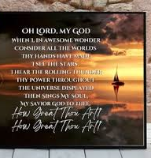
Disembarkation: Souvenirs and Support – Smooth Sailing Playlist
Hymns: How Great Thou Art, It Is Well With My Soul, My Soul Looks Up to Thee, Be Still My Soul
Cruisin’ – Smokey Robinson
Sailing – Christopher Cross
Cruising – Lecrae
Orinoco Flow – Enya
The Love Boat (Theme Song) – Dominik Hauser
Kokomo – The Beach Boys
(Sittin’ On) The Dock of the Bay – Otis Redding
Under the Sea (from The Little Mermaid) – Samuel E. Wright & Disney
Three Little Birds – Bob Marley & The Wailers
Unforgettable – Natalie Cole & Nat King Cole
Over the Rainbow – Aretha Franklin
My Favorite Things (from The Sound of Music) – Julie Andrews

Slide 21
Wishing you all smooth sailing!
Kelly G. Loeb
Workshop Presenter
kellygloeb@gmail.com
913-706-2194
Copacabana Beach, Rio de Janeiro, Brazil

